Slide 1

Nightwing
Wasif Siddique Tech intern
Monday, August 12th 2019
Notes:
Hi everyone, my name is Wasif Siddique and I’m a tech intern working in the Engineering Infrastructures org. The name of the project I’ve been working on is called Nightwing, and today we’ll go into an overview of this application.

Slide 2

The team
Provisioning Configuration Management
Notes:
As part of Infrastructure Engineering, PCM supports Linux, Windows, Solaris, BigIP, Chef, and related services. The team provides configurations for on-prem servers to customers and also manages tools and products like xymon, Packer Pipeline, VCommander etc.

Slide 3
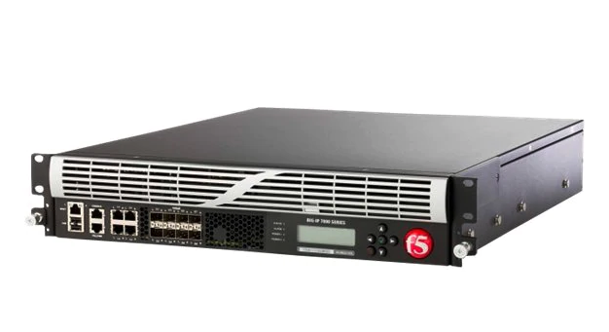

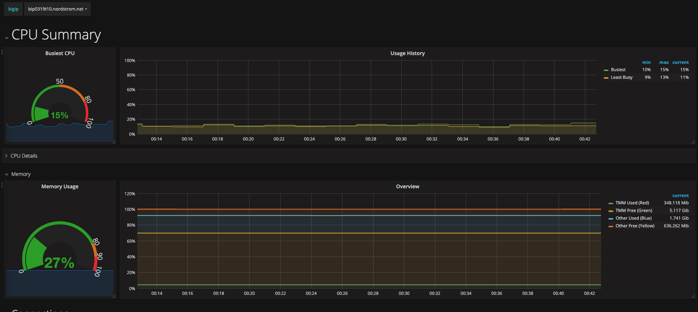
Problem statement
Big IP monitoring
F5’s BIG-IP Local Traffic Manager (LTM) devices provide high availability load balancing.
BIG-IP monitoring is important to visualize device statistics (e.g CPU, memory util graphs)
F5 Networking BIGIP 7255V LTM 32GB DUAL SSD
Heimdall
Current monitoring solution. Utilizes Prometheus (SNMP exporters,
Grafana, and AlertManagers)
Carries a lot of tech debt, doesn’t utilize company standard Datadog.
Big IP data scraped by Heimdall is visualized here using Grafana
So how can we reduce this debt and implement a simpler solution for monitoring Big-IP?
Notes:
PCM supports BIG IP Local Traffic Management devices. These devices use high availability load balancing to provide intelligent network traffic management. Monitoring Big IP performance helps us look at system level health, and other BIG IP related metrics.
Our current monitoring solution is Heimdall, which utilizes a few components such as Prometheus, Grafana to visualize the Big IP, which makes it a complex solution. Heimdall carries a lot of tech debt, and it doesn’t utilize Datadog, which is a standard for telemetry around teams in Nordstrom tech.
So, how can we reduce this debit and implement a simpler solution for monitoring BIG-IP?

Slide 4
Presenting
NIGHTWING
Notes:
Here’s my answer for a simpler monitoring solution. Introducing, Nightwing!

Slide 5
Nightwing: general overview
Creates a connection to a Big IP device
Exports all system stats for LTM(Local Traffic Manager)
Uses a config file to populate static values to a metric
Posts metrics to Datadog to create a time board of all Big IP devices
Notes:
Nightwing, from the DC comics is an amazing spy who gathers data and provides monitoring for Batman, helping the dark knight in his work. Hence, I’ve named this application Nightwing. Let me get into why.
Nordstrom’s standard for telemetry now is Datadog, and anyone working in technology can easily pull up dashboards as needed. We have 3 environments of BIG IP devices, which are prod, DMZ and testing.
Nightwing starts with making a stable connection to each device, then scrapes all the SNMP data values stored in go structs. It uses a snmp.yml file to pull static values that doesn’t change over time, such as data attribute names, data types or if there’s multiple interfaces containing the same attributes.
For each data attribute, it builds a datadog metric containing host name, metric name, tags and then posts to datadog right away.
We can then access Datadog after it runs and start dashboarding with the data Nightwing sent to Datadogs

Slide 6
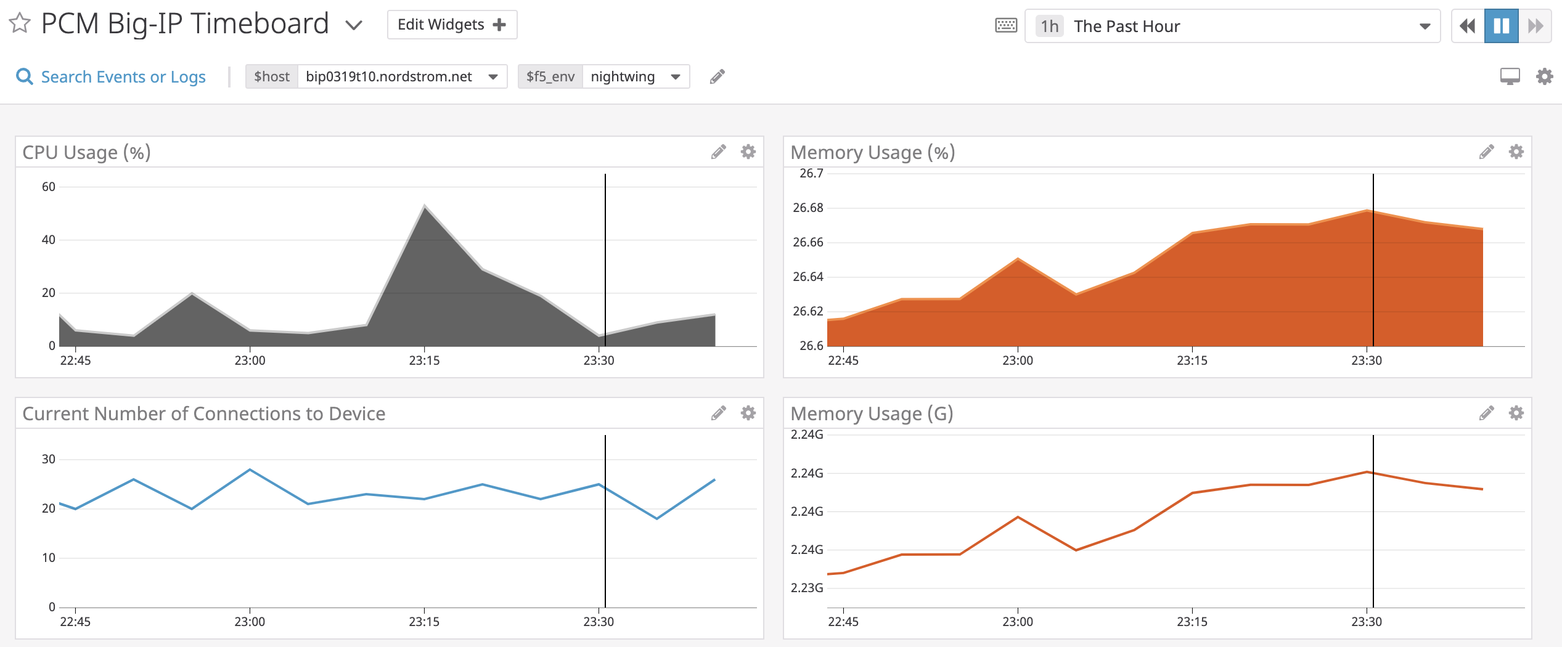
Metric dashboards
Notes:
For now, these are the dashboards I’ve created on Datadog. With all the data that Nightwing has pushed to datadog, we have 225 BIG IP metrics in the datadog api that can be used to create a lot more dashboards just like this.

Slide 7
Key Takeaways
Helps app dev monitor resources
Helps them assess if their application is overutilizing resources
Provides a holistic visual of backend operations
Notes:
Here are some key takeaways from dashboarding BIG IP metrics. Application teams can check the current time board to see how BIG IP system is doing. When we add VIP level metrics to this dashboard, app developers can monitor if their application is utilizing high resources on the on prem servers, which in return can help them with reiterating application design.

Slide 8

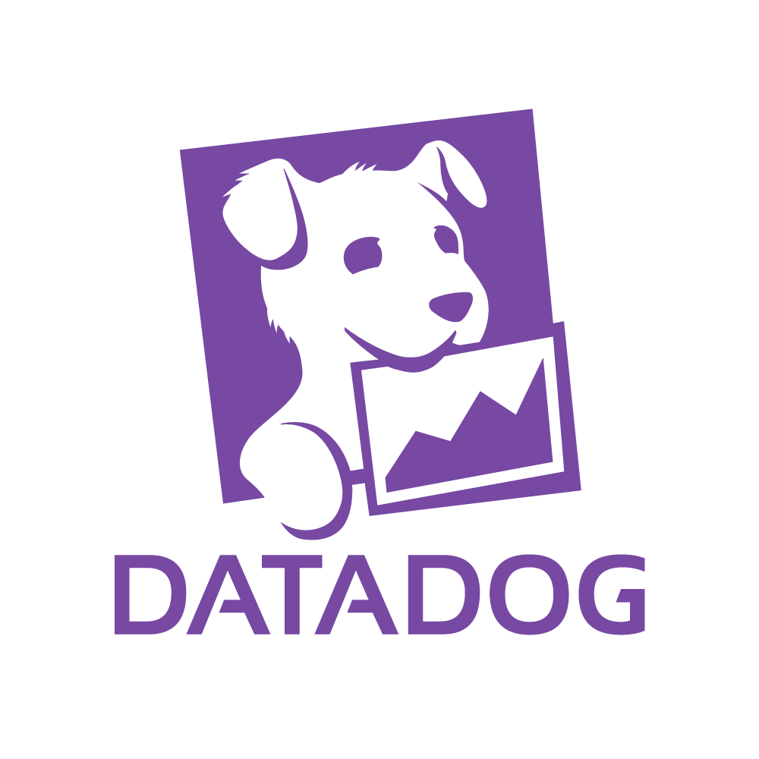

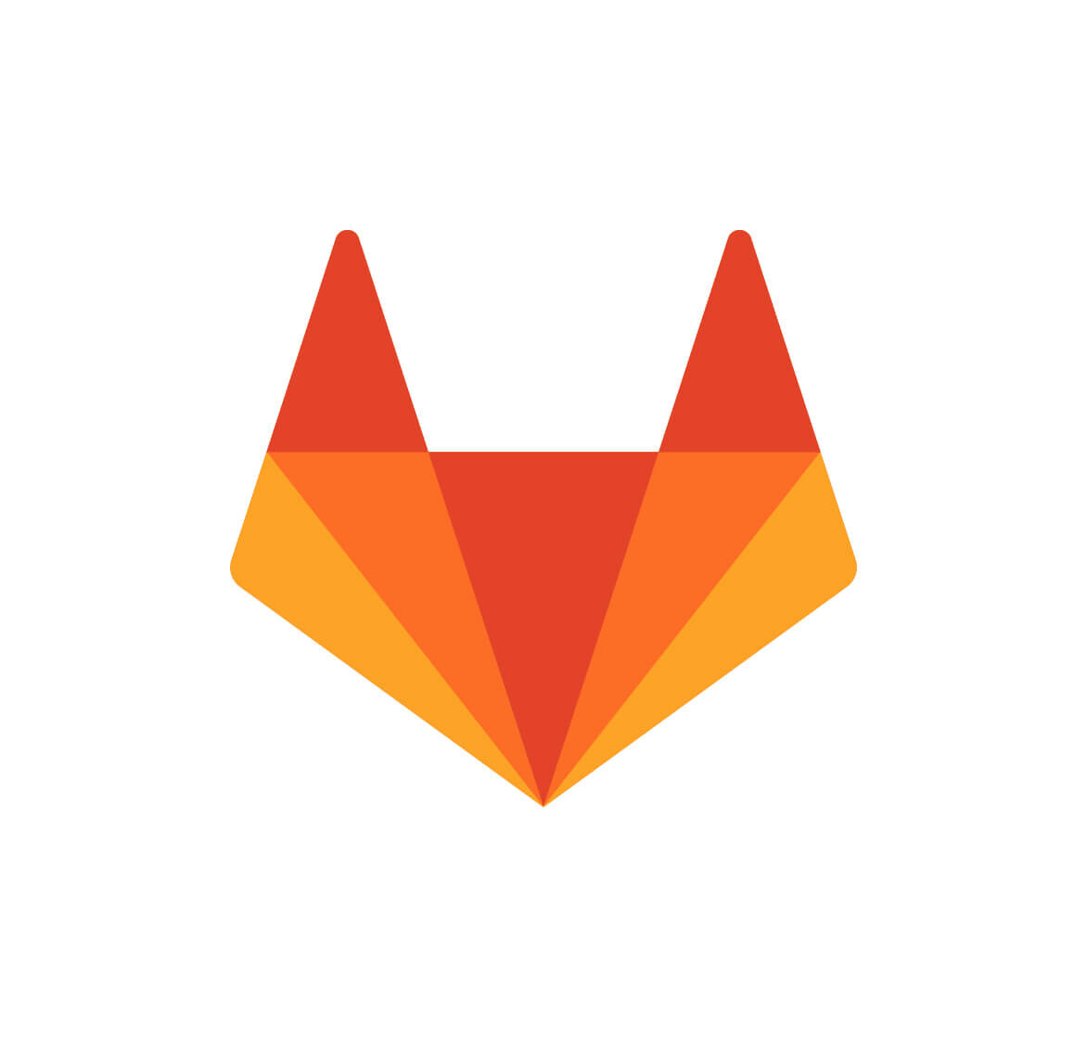
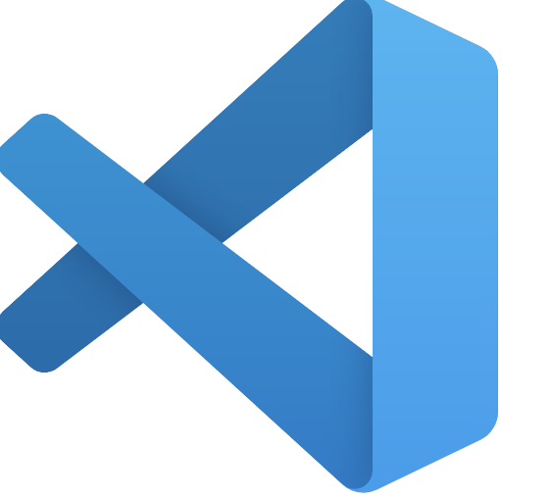
Tech Stack
GOSNMP API
Datadog GO API
Datadog Timeboards
SonarQube
Gitlab Secret Variables
Notes:
Nightwing is written in GOLANG. It uses the GOSNMP API to connect to big ip and walk all the devices to gather SNMP data. I also used a go API for sending data metrics to Datadog’s endpoints. Gitlab secrets contain all the BIG IP authentication details as well as API keys and APP keys for datadog. Sonarqube helps check for code spills, vulnerabilities, which in turn helps me write a more secure better application.

Slide 9

Challenges and lessons
Notes:
Challenges I’ve faced and the lessons I’ve learnt as I worked on this project:

Slide 10
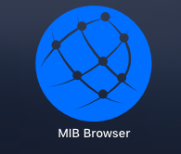
Key challenges And Lessons
Challenges:
Learning how to work with MIB (management information base) network objects and SNMP (Simple Network Management Protocol)
Name of the game: Design Iteration
Lessons learned
Datadog only takes metric values in the form of gauge, counter, floats. We expected it to ingest string values like Grafana did for Heimdall.
Picking up Golang, how to dashboard on Datadog.
Notes:
One of the challenges I had was to learn how to work with MIB network objects and SNMP. It took me a little while to understand how these data objects are received and one of the tools that I really appreciate using is the Mib Browser.
As I learnt more about the datatypes datadog ingests, or more complexities revolving mib data, I had to go back and reiterate the way Nightwing scrapes data from the F5 devices. This was challenging at first, but with a few iterations on the design and help from my mentor I was able to solve that problem.
So things I’ve learnt: Datadog only takes metric values in gauge, counter or floats, so that can impact what kind of data are you planning on sending to datadog. I’m primarily a java developer but learning golang for this project was pretty fun. I also learnt how to dashboard on datadog.

Slide 11
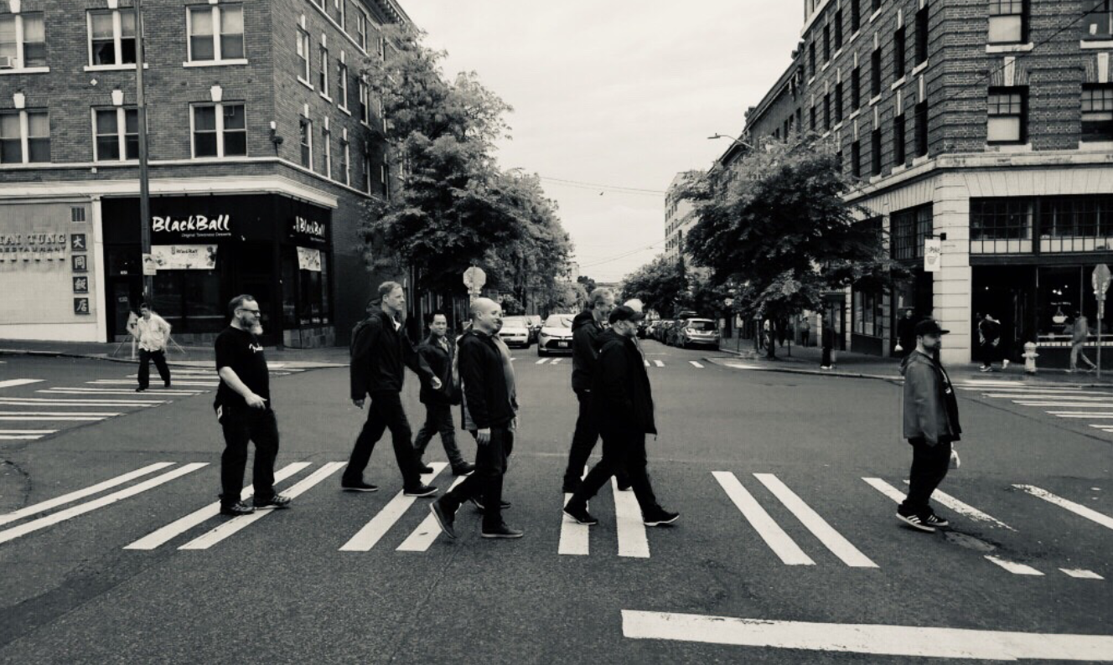
Special Thanks
Mentor: Jacob Ingram
Manager: Will Moss
The PCM team
Notes:
So that concludes what I’ve been working on for my summer project. Special thanks to my mentor for helping me throughout this project with architecture designs, answering questions whenever I was stuck on any piece of the code. Thanks to my manager for thorough feedback that helped me grow as a better engineer during this internship program. Also, thank you everyone in the PCM team for your amazing support.

Slide 12

Q & A
Notes:
Any questions?

Slide 13
Thank you
Notes:
Thank you everyone.

